Slide 1
Unmanned Ground Vehicle
Group # 3
Kazu Arai, Rudolf Eramus
Supervisors: Dr Colin Bradley,
Dr Alexandra Branzan Albu

Slide 2
Introduction
About Us
Our Project
Current Progress
Major Components List
Questions

Slide 3
About Us
Rudolf Eramus
Electronic Engineering Technology Diploma from Okanagan College
4th year Electrical Engineering Student
Designed, built and tested two small robots

Slide 4
About Us
Kazu Arai
Mechatronics and Robotics Diploma from BCIT
4th year Computer Engineering Student
Member of AUVic (Autonomous Submarine Team)
President of UVic AERO (Unmanned Aerial Vehicle Team)

Slide 5
Our Project
Unmanned Ground Vehicle for the Unmanned Systems Canada’s Student Competition
Fire Safety
Finding Fire Breaks

Slide 6
Our Project
To start a UGV Team at UVic
399 for Research
499 to Build and Test
Requirements
Size and Weight
Simulation before being allowed to compete

Slide 7
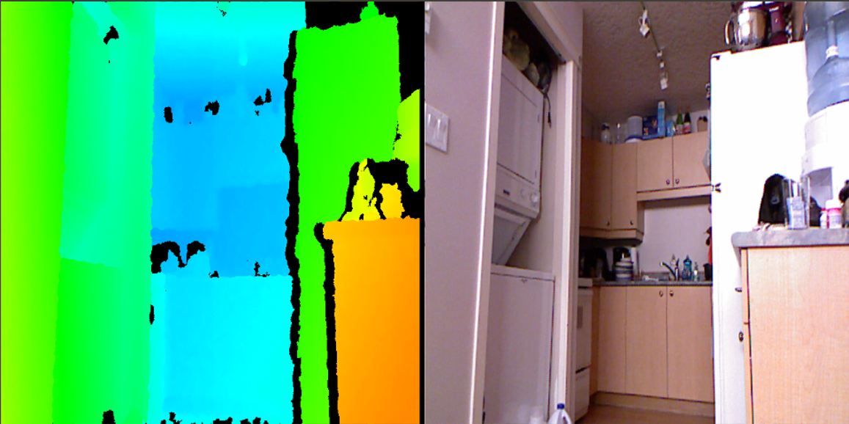
Current Progress
Have decided on many of the components
Running vision software and simulation software
Overall plan for the Robot Build

Slide 8
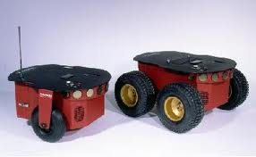
Major Components List
Kinect Controller
Ardupilot for sensors
Laptop w/ Ubuntu for controller
MobileRobots Pioneer Series Robot base

Slide 9
Questions?

